Slide 1
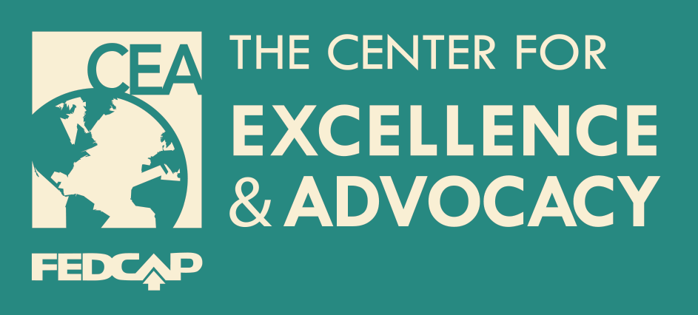
Practice Improvement Institute
Transition Series: Culturally Sensitive Transition Planning
October 30, 2014

Slide 2
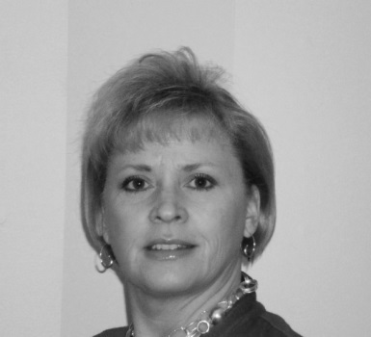
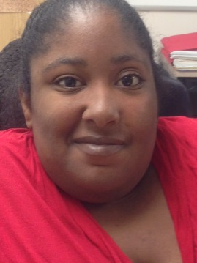
Practice Improvement Institute Presenters Culturally Sensitive Transition
Lori Norris
CEA Director
Edda Carmadello
Central Falls
Sofia Diaz
Central Falls

Slide 3
Transition Series
Description: This eight part training provides a practical, in-depth and innovative approach to the process of helping youth with intellectual / developmental disabilities transition to jobs and college after graduation.

Slide 4
Transition Series Description
Part I: Youth Employment 101 for Educators: Stipends, wages, unpaid work… know the rules!
September 9, 2014 2:30pm – 3:30pm Webinar
Part II: The Nuts and Bolts of Transition - What Parents New to Transition Should Know
September 16, 2014 2:30pm – 3:30pm Webinar
Part III: Strengthening Collaborations for Better Transition Outcomes
September 23, 2014 2:30pm – 3:30pm Webinar
Part IV: Using Rapid Job Placement in Transition
September 30, 2014 2:30pm – 3:30pm Webinar
Part V: Employer Expectations - Preparing youth for the contemporary labor market
October 9, 2014 2:30pm – 3:30pm Webinar
Part VI: Assessing Work Aptitudes and Attitudes of Students in Transition
October 16, 2014 2:30pm – 3:30pm Webinar
Part VII: Finding Jobs for Students with Disabilities: A Practical Step by Step Training for Educators
October 23, 2014 2:30pm – 3:30pm Webinar
Part VIII: Culturally Sensitive Transition Planning
October 30, 2014 2:30pm – 3:30pm Webinar

Slide 5
What Is Commonly Rooted In Transition Services / Systems
Individualism – people should move from dependence to independence and self-reliance
Focus on –
Self – self-advocacy, self-evaluation, self-awareness, self-observation, etc.
Individual rights
Setting and achieving personal goals
Pursuing personal interests
Being true to self and own values and beliefs
Freedom to choose
Personal Control

Slide 6
What Is Commonly Valued In Culturally and Linguistically Diverse Communities
Collectivism – rooted in the view that people are woven into the fabric of groups like families, neighborhoods, tribes, etc. and that as they transition to adulthood they should move from dependence to interdependence.
Focus on –
Obligations that go along with one’s group roles
Being an interdependent member of a group
Working with others to achieve group success
Adhering to groups traditional values
Relationships define the person vs. the person defines/creates relationships
Others-oriented rather than self-oriented
* (Ewalt & Makuau, 1995)

Slide 7
CLD Values that Could Impact Transition Services
Individualistic Values
Self-determination and individual choice
Individual competitiveness & personal achievement
Post-secondary education
Independent living and self-reliance
Creating a transition plan on paper
Source: Ici.umn.edu
CLD Values
Group or hierarchical decision making
Group competitiveness & group achievement
Contributing to the family through wages and housework
Residing with family, interdependence and being cared for
Establishing close personal relationship between professionals, youth and the family

Slide 8
Cultural Reciprocity
You do not need to be a subject matter expert to create a culturally sensitive transition plan. Rather, work objectively and recognize that expectations of parents, youth, teachers, education may differ greatly from ours.
Questions you could consider to assist in the planning process
What languages are spoken in the home and by which members?
What are the family’s norms for personal and social development for the youth with disabilities (to what degree is independence encouraged?)
What post-secondary or work related goal does the family have for the youth?
What are the family’s views on disabilities and how does it affect their treatment of the youth?
What are the family’s decision making practices – is there someone who holds the decision making power?
Notes:
Inserting white, middle-class culture causes clashes, mistrust, sends a message of ‘less than’ and negatively impacts the services to the student.
Indochinese do not take active roles in schools (Manning & Lee, 2001)
Brazilians will only recognize and accept homework when the school day is shortened (DeCarvalho, 2001)
Jose – 21 year old Latino with mild DP and MR. Jorge’s family owned a cattle farm and wanted him to work on the farm upon graduation. Jose wanted to take agricultural classes as he wanted to meet people and socialize with his peers. The family needed his assistance on the farm and at first shut down Jose’s plan to take classes. It took a year of sharing and reinforcing Jose’s desires and needs but through patient planning in small chunks the Jose’s parents finally agreed.

Slide 9
Exploring Cultural Norms
Portuguese –
Family is the foundation of the social structure and forms the basis of stability.
Loyalty to the family comes before other social relationships, even business.
A culture that respects hierarchy – age and position.
Prefer face to face meetings rather than written or communication by phone which are seen as too impersonal.
Do not appreciate direct criticism, even if justified.
More relaxed attitudes towards time and do not see deadlines as crucial as people from many other cultures do.

Slide 10
Exploring Cultural Norms
Southeast Asian –
Highly group-oriented people who place a strong emphasis on family connection as main source of identity and protection.
Independent behavior that may disrupt the harmony of family life is highly discouraged.
May be unwilling to acknowledge strong emotion, grief, or pain due to their family and cultural values.
An intentional lack of directness in conversation is favored because preserving harmony between people is often more important that getting at the exact “truth”.
High context culture in which gesture, body language, eye contact, pitch, intonation, word stress and the use of silence are as important as the actual words beings spoken.

Slide 11
Latino Student Achievement in Rhode Island
16.7% of US population is Latino.
21% of RI residents are Latino; 18% of them are under the age of 18.
63% of students are Latino in Providence; 72% in Central Falls.
Latino students in RI lag behind Latinos in other states on reading and math measures by as much as a full grade level.
Latinos in RI drop out of high school at a higher rate and they are chronically absent in schools by higher percentages.
Absentee Rate All Schools High School
Central Falls 28% 51%
Providence 32% 56%
2013 RWU Latino Policy Institute

Slide 12
Student Achievement in Central Falls
Highest teen birth rate in the state for all age groups.
Child abuse and neglect is the 2nd in the state.
Highest student mobility rate in the state – 24% of students enroll and exit during one year.
27% of Central Falls students are classified as ELL students – highest in the state.
23% of Central Falls students are receiving special education students.
Math proficiency rates are the lowest in RI for 8th and 11th grade.
2014 Rhode Island Kids Count Fact Book

Slide 13
Efforts to Improve
Universal Breakfast Program – All elementary school students eat breakfast in the classroom. All middle and high school may receive breakfast before the start of the school day.
Attendance campaigns throughout the district – elementary school counselors work with building principals to increase attendance.
Restorative practices infused throughout all facets of the school day – circles, mediation, after school circles.
Alternative ways to be educated - virtual programs, PM school, Saturday credit recovery, Expanded Learning Opportunities.
Partnership with Rhode Island College - developing a PreK-20 program
Parent College - Night school for families - daycare and dinner provided

Slide 14
Sofia Diaz Central Falls High School Graduate
Class of 2013
Currently employed by the Central Falls School District
Member of the Central Falls Transition Team
Presented Dare to Dream Conference
Guest speaker for Special Education Educators Professional Development
Speaks to church organizations
Organizing a community food drive for homeless people
Participating in today’s webinar

Slide 15
Solutions
Convey high expectations for youth.
Link youth with mentors to encourage commitment to academic excellence and social skill development.
Create circle of support .
Advocate for increased cultural competence of instruction.
Seek the input of cultural experts.
Conduct trainings using culturally sensitive self –determination and/or self advocacy curricula and clued family and community in the training.
Support youth to meaningfully participate in, and preferably lead, their IEP meetings.
Advocate for school-wide climate of acceptance.
Support youth/families to identify and access technology resources.
NCSET Essential Tools 2005

